Slide 1

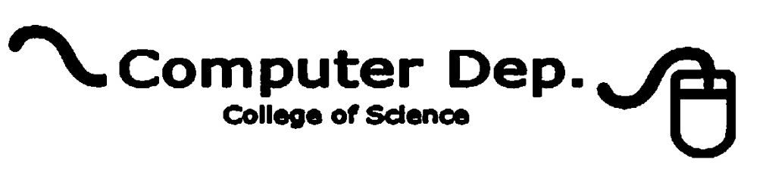
Discrete mathematics and its application
Lamya A. Omer
Lecture1 – part 1
2nd Stage
2020-2021
lamya.omer@uod.ac

Slide 2
What is Discrete Mathematics?
You learn continuous math. It deals with continuous functions, differential and integral calculus.
In contrast, discrete math deals with mathematical topics in a sense that it analyzes data whose values are separated (such as integers: integer number line has gaps) Here is a very rough comparison between continuous math and
discrete math: consider an analog clock (one with hands that continuously rotate, which shows time in continuous fashion) vs. a digital clock (which shows time in discrete fashion).

Slide 3
Discrete Data & Continuous Data
Discrete Data
Data that can only take certain values.
Continuous Data
Data that can take any value (within a range)

Slide 4
Discrete Mathematics
Discrete Mathematics is a branch of modern mathematics which is deals with discrete objects. Discrete objects are those which are separated from (not connected to / distinct واضحة المعالم from) each other.
Discrete mathematics, or finite mathematics, involves breaking up sets of elements into separate or discontinuous parts.

Slide 5
Why Care about Discrete Math?
Digital computers are based on discrete “atoms” (bits).
Therefore, both a computer’s
  structure (circuits) and
  operations (execution of algorithms)
can be described by discrete math.

Slide 6
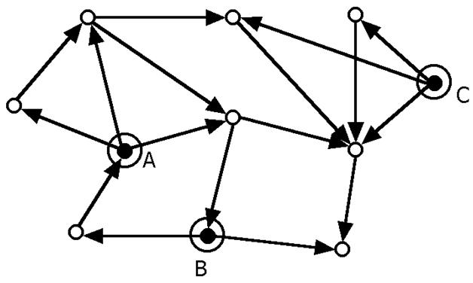
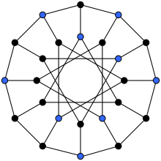
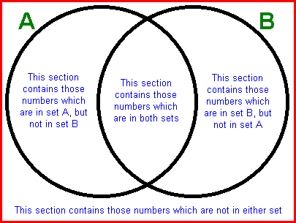
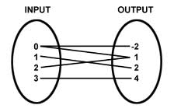

Slide 7
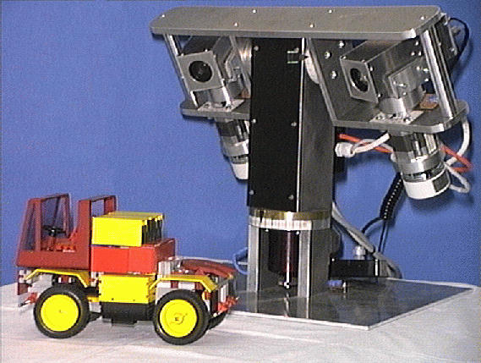
Computer Vision:

Slide 8
Logic
Logic is a language for reasoning. It is a collection of rules we use when doing logical reasoning. It is the study of abstract reasoning specifically concern whether is correct or not , focuses on the relationship among statements.
These rules are used to distinguish between valid and invalid mathematical arguments.

Slide 9
Logic
In English we deal with sentence .
We call this sentence in mathematic statement now in logic we call it proposition if this statement has a truth value.
Our goal to change the proposition into computerize language

Slide 10
Logic
In logic we are interested in true or false of statements, and how the truth/falsehood of a statement can be determined from other statements.
However, instead of dealing with individual specific statements, we are going to use symbols to represent arbitrary statements so that the results can be used in many similar but different cases. The formalization also promotes the clarity of thought and eliminates mistakes.

Slide 11
Types of logic
There are various types of logic such as
1- logic of sentences (propositional logic).
2- logic of objects (predicate logic).
3- logic involving uncertainties.
4- logic dealing with fuzziness, temporal logic etc.
Here we are going to be concerned with propositional logic and predicate logic, which are fundamental to all types of logic.

Slide 12
Logic
Logic is a system based on propositions.
A proposition is a declarative sentence that is either true or false. but not both.
Propositional Logic is the logic of compound statements built from simpler statements using so-called Boolean connectives.
Some applications in computer science:
Design of digital electronic circuits.
Expressing conditions in programs.
Queries to databases , search engines & knowledge base.

Slide 13
Outline of logic topic
Statements are either:
1- Simple statement.
2- Compound statements
3- Conditional statements
4- Quantified statements.

Slide 14
Introduction to Propositional Logic
Thus sentences considered in this logic are not arbitrary sentences but are the ones that are true or false. This kind of sentences are called proposition
A proposition is a statement that is either true or false (not both).
We say that the truth value of a proposition is either true (T) or false (F).
Corresponds to 1 and 0 in digital circuits

Slide 15
The Statement/Proposition
“Elephants are bigger than mice.”
Is this a statement?
yes
Is this a proposition?
yes
What is the truth value
of the proposition?
true

Slide 16
The Statement/Proposition
“520 < 111”
Is this a statement?
yes
Is this a proposition?
yes
What is the truth value
of the proposition?
false

Slide 17
The Statement/Proposition
“y > 5”
Is this a statement?
yes
Is this a proposition?
no
Its truth value depends on the value of y, but this value is not specified.
We call this type of statement a propositional function or open sentence.

Slide 18
The Statement/Proposition
“Today is January 24 and 99 < 5.”
Is this a statement?
yes
Is this a proposition?
yes
What is the truth value
of the proposition?
false

Slide 19
The Statement/Proposition Game
“Please do not fall asleep.”
Is this a statement?
no
It’s a request.
Is this a proposition?
no
Only statements can be
propositions.

Slide 20
The Statement/Proposition
“If elephants were red, they could hide in cherry trees.”
Is this a statement?
yes
Is this a proposition?
yes
What is the truth value
of the proposition?
probably false

Slide 21
The Statement/Proposition
“x < y if and only if y > x.”
Is this a statement?
yes
Is this a proposition?
yes
… because its truth value does not depend on specific values of x and y.
What is the truth value
of the proposition?
true

Slide 22
A Paradox
• “I am lying”: Is he speaking the truth or lying?
True or False??
– Neither True nor False.
– If the statement is true, then he says he is lying, that is if he says the truth he is lying
– If the statement is false, then his statement, “I am lying” is false, which means he is telling the truth
– Thus, although it appears that the statement is a proposition, this is not. As this cannot be assigned a truth value.

Slide 23
Propositions
A proposition is a declarative sentence that is either true or false.
Examples of propositions:
Toronto is the capital of Canada.
Trenton is the capital of New Jersey.
The Moon is made of green cheese.
1+ 0 = 1
1+2 =1
Examples that are not propositions.
x + 1 = 2
What time is it?
Sit down!
x + y = z

Slide 24
Decide which of the following are propositions
1- “ It is raining”
2- “1 + 2 = 3”
3- “Who ís there?
4- “La la la la la.”
5- “Just do it!”
6- “1 + 2”
7- Washington D.C. is the capital of China.î

